Slide 1


Firebase Messaging
Author: Khanh Nguyen
06/2023

Slide 2


TABLE OF CONTENTS
01.
04.
06.
What is Firebase Cloud Messaging
FCM Messages
Demo
02.
05.
07.
Why FCM
Pros and Cons
Q&A
03.
FCM Architecture

Slide 3


What is Firebase Cloud Messaging

Slide 4
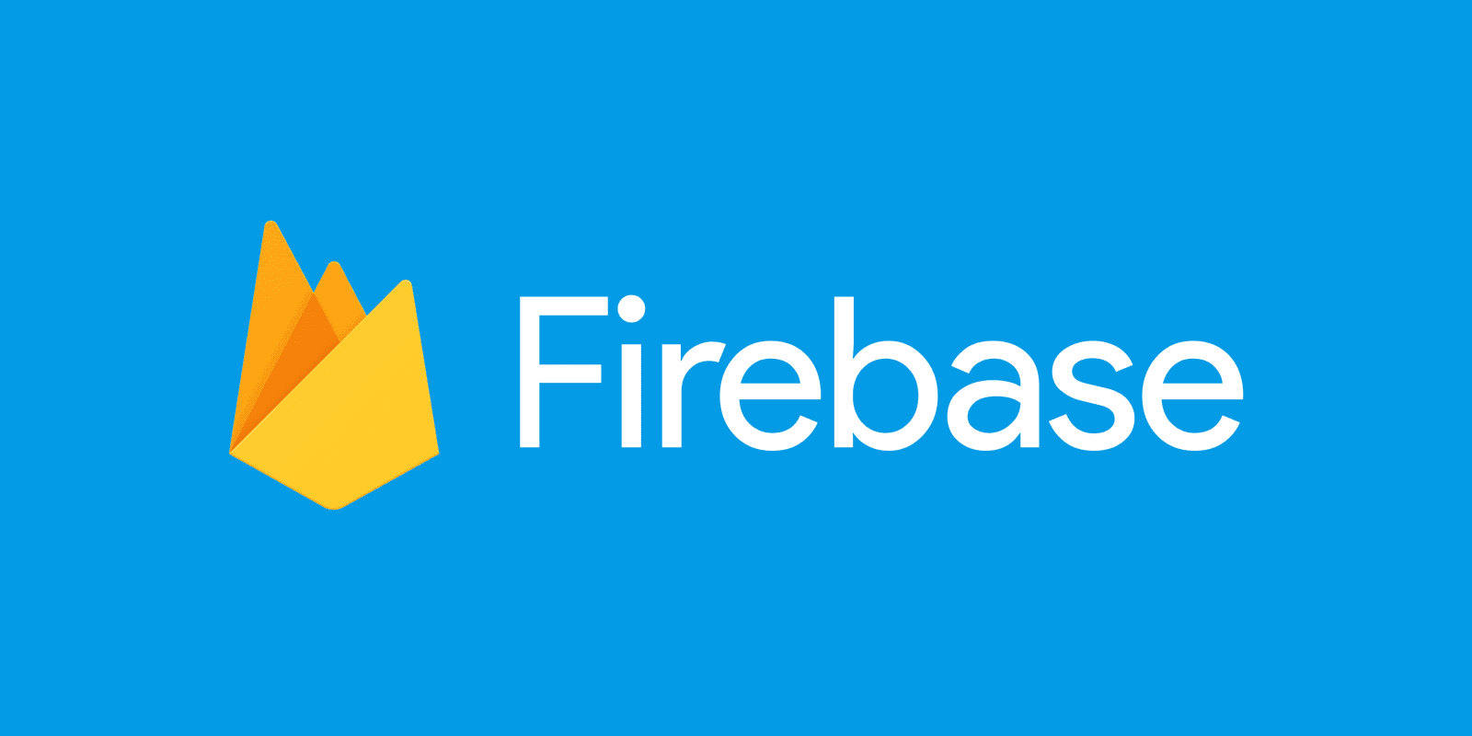
What is Firebase
Comprehensive platform developed by Google
Offers feature such as storage data, authentication, hosting, cloud functions, and more…

Slide 5
Firebase main features
Real-time Database
Authentication
Cloud Firestore
Cloud Storage
Hosting
Cloud Functions
Analytics
Performance Monitoring
Machine Learning
Cloud Messaging

Slide 6
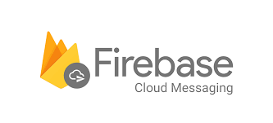
Firebase Cloud Messaging
Enables you to send push notifications to users on multiple platforms, including Android, iOS, and web.
Key capabilities:
Send notification messages or data messages
Versatile message targeting
Send messages from client apps

Slide 7
Why FCM

Slide 8
Why FCM
Cross-platform support
Scalability and reliability
Battery efficiency
Simplified implementation
Additional features
Notes:
FCM supports sending push notifications to multiple platforms, including Android, iOS, and web
FCM is a cloud-based service provided by Google, which means it is designed to handle high volumes of notifications and provide reliable delivery.
FCM uses a battery-efficient mechanism to deliver push notifications to mobile devices.
Firebase provides SDKs and libraries for various platforms, making it easier to integrate push notifications into your application
FCM offers additional features beyond just sending push notifications. It provides analytics, targeting capabilities, topic-based messaging, and integration with other Firebase services.

Slide 9
FCM Architecture

Slide 10
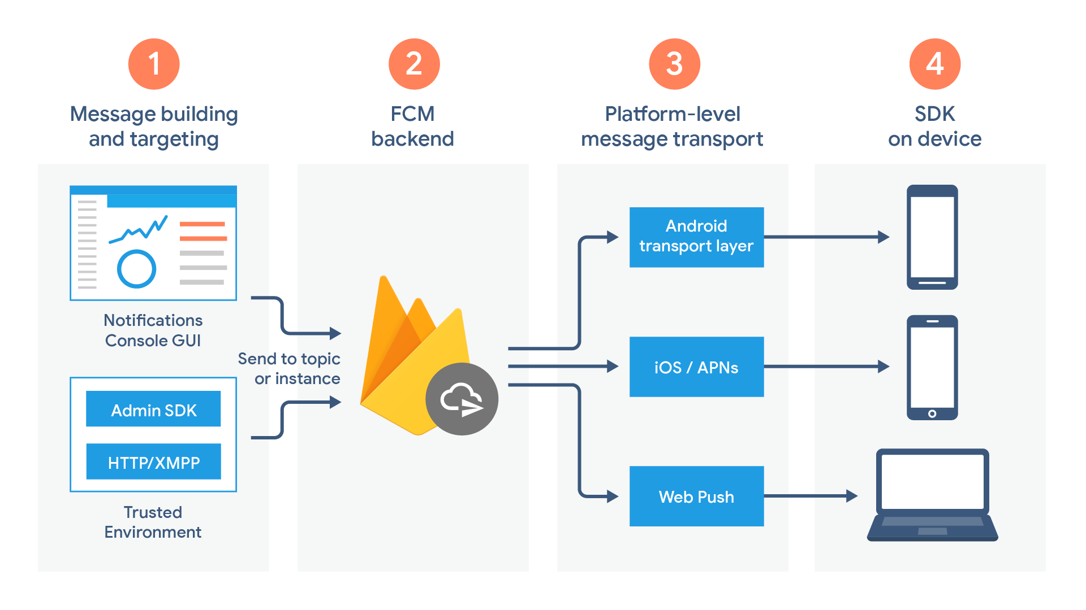
FCM Architecture Overview
Notes:
Message building and targeting, có thể sử dụng các công cụ như console của google, admin sdk hoặc là http request
FCM backend, server riêng của FCM để xử lý việc tạo notification, generate các metadata của message(ví dụ như message id)
Nơi điều hướng message đến với target device, chia ra làm 3 platform chính là android, ios và web
Cuối cùng là gửi đến device, tùy thuộc vào logic và cách handle sẽ có những cách nhận thông báo khác nhau

Slide 11
Lifecycle flow
Register devices to receive messages from FCM
Send and receive downstream messages:
The message is composed
FCM receive request, send message
Message sent via platform-specific to device
Device receive message

Slide 12
FCM Messages

Slide 13

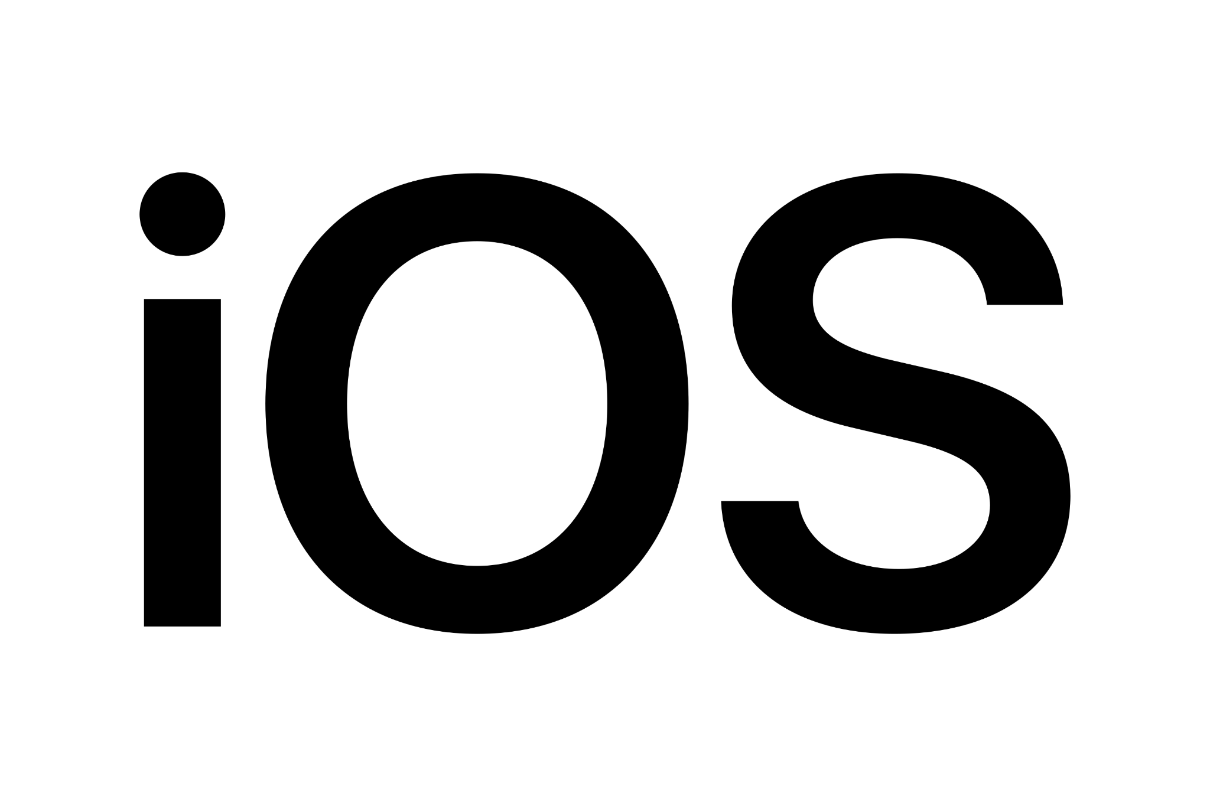
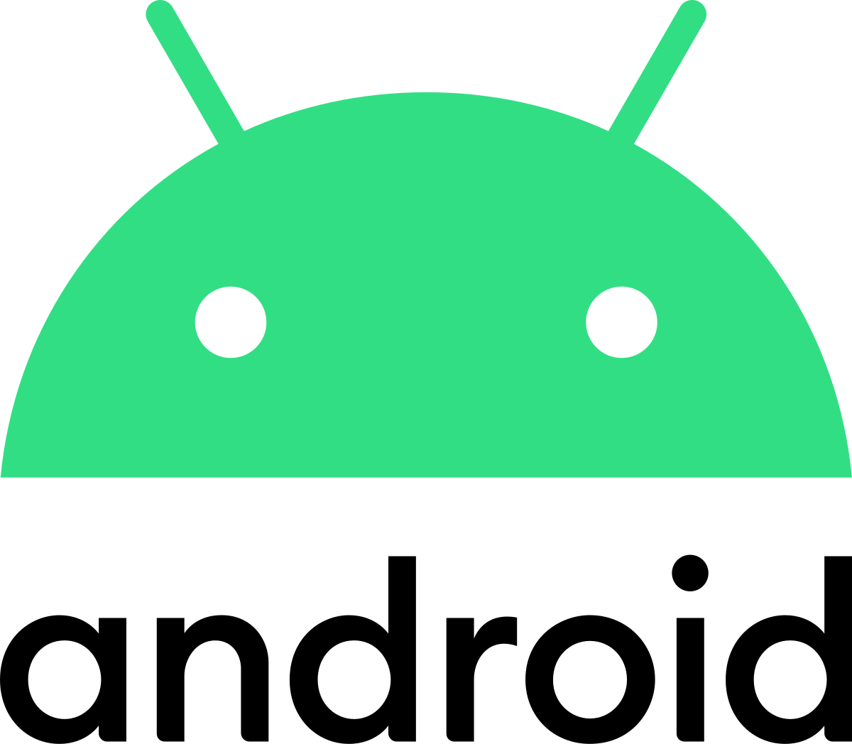
FCM messages
2 types of FCM messages:
Notification messages: when we want to send push notifications
Data messages: when we want to custom notifications, e.g Toast message.
Messages:
Have common fields regardless platform
Beside that, each platform has custom fields
Notes:
Notification messages: handled by the FCM SDK automatically.
Data messages, which are handled by the client app.
time-to-live is set on Android as an expiration time in seconds, while on Apple it is set as an expiration date.

Slide 14
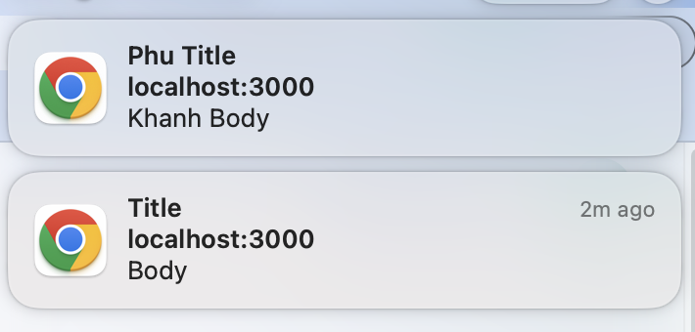
FCM common notification fields
Common fields:
message.notification.title
message.notification.body
message.data
Notes:
FCM messages sẽ có 3 common field bất kể các platform
Bên cạnh title và body được hiển thị để thông báo notification, data là những thông tin thêm đính kèm mà chúng ta muốn gửi về cho client.

Slide 15
Pros and Cons

Slide 16
Pros and Cons
Pros | Cons
Cross-platform support | Dependency on Google infrastructure
Scalability and reliability | Limited customization
Battery efficiency | Data privacy concerns
Easy implementation | Platform-specific limitations
Rich notification support | Limited offline capabilities
Targeting and segmentation
Notes:
FCM messages sẽ có 3 common field bất kể các platform
Bên cạnh title và body được hiển thị để thông báo notification, data là những thông tin thêm đính kèm mà chúng ta muốn gửi về cho client.

Slide 17
Demo

Slide 18
Q & A

Slide 19

THANK YOU!

